Slide 1
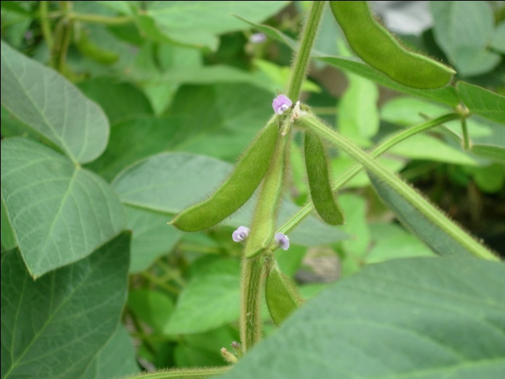
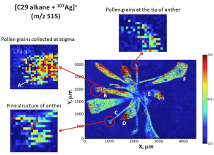
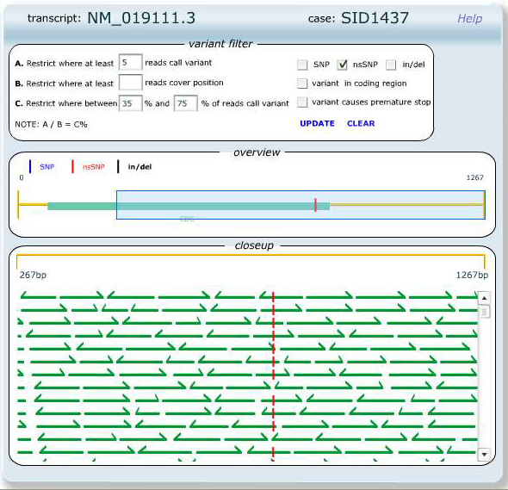
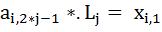
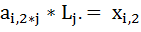
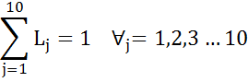
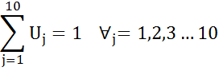

Redesigning Plant Breeding Systems
15 February 2019
Translational Genomics Forum
Stillwater, Ok
Bill Beavis
Lizhi Wang
Guiping Hu
Sotirios Archontoulis

Slide 2
Redesigning Plant Breeding Systems: Motivation
Average Yield for Corn and Soybean

Slide 3
Pipeline Representation of Cultivar Development
Develop
Replicable
Genotypes
Replicated
Field Trials
Cross
METs
Commercialize
Currently, we integrate new technologies and discoveries into existing breeding systems using ad hoc approaches. We do this because we can and we are afraid that our competitors will. We do not know if the resulting design are optimal. – Ted Crosbie, 2009
Develop
Replicable
Genotypes
Replicated
Field Trials
Cross
Introgress
METs
Commercialize
Notes:
At one time, education of plant breeders involved learning about many possible breeding designs including BC, Pedigree, Mass Selection, half sib selection, full sib selection, Recurrent Selection, Reciprocal Recurrent Selection.
Within ten years most recurrent selection programs in the US disappeared as academics tried to adopt the dominant paradigm that had emerged in the commercial sector.

Slide 4
Representations of Line and Hybrid Cultivar Development Systems
Develop
Replicable
Genotypes
Replicated
Field Trials
Cross
Introgress
METs
Commercialize
Cross
Develop Replicable
Homozygous Lines
Replicated Evaluations
Lines per se + Hybrids
Introgress
METs
Commercialize
Cross
Develop Replicable
Homozygous Lines
Replicated
Evaluations
Introgress
Commercial plant breeding has become an escalating arms race where large seed companies ask farmers to pay for integration of new technologies and ever expanding numbers of field trials. We need to be more efficient not more expensive. Joe Byrum, 2009

Slide 5
Redesigning Plant Breeding Systems
As Biology is transformed from an observational to a predictive science, Plant Breeders have the opportunity to return to their original role as designers of Genetic Improvement Systems.
Proposal: Redesign plant breeding systems using principles and methods from Applied Mathematics
Objectives
Model
Algorithm
Solver
Notes:
As Physics moved from observation generated hypotheses to hypotheses generated based on model-based predictions, the associated mechanical arts were transformed into
My first plant breeding job was to design systems to introgress Sorghum genomes into nine MS Cytoplasms and to design a system for reciprocal recurrent selection using genetic male sterility in Sorghum.

Slide 6
Premise: Plant Breeding is a Decision Making Discipline
Usually, decision making requires tradeoffs.
Cultivars should be designed based on knowledge of attributes needed by farmers.
How to create a cultivar will be constrained by reproductive biology, access to technologies, budgets and time.
How to create the cultivar should be influenced but not constrained by historical designs of breeding systems.
Notes:
Example: choice of molecular marker technologies. There is no universal marker technology that is best for all breeding objectives. If no more than a few hundred loci are assayed tape array technologies are less expensive than GBS technology platforms.
Historically, cultivars have been discovered through trial and error.

Slide 7
Proposal: Redesign plant breeding systems using Applied Mathematics
Develop
Replicable
Genotypes
Replicated
Field Trials
Cross
Introgress
METs
Commercialize
Example 1: Marker Assisted Introgression
Hypothesis: After 20+ years of research on marker assisted backcrossing, applied mathematics will not improve the best known selection strategies for introgressing a single desirable allele from an unrelated donor.
Notes:
Consider BC breeding. While first communicated in a science journal in 1922 by Harlan and Pope Journal of Heredity 13:72-75 had been known by plant breeders of self pollinated crops long before.
With emergence DNA markers at least a dozen publications on how to best

Slide 8
Define Objectives and Translate to Objective Functions
Objectives
Model
Algorithm
Solver
Deb, 2001
Konak et al, 2006
Notes:
Objectives could be to minimize. Could be a mixture of maximize and minimize
Use example of Maximize Probability of

Slide 9
Example 1: Define Measurable Objectives
Breeding objectives (Peng et al, 2014):
Minimize costs to create a set of four ILs in less than five generations with an average of no more than 1 cM of the genome from the DL is present within 20 cM of el with an average of no more than 8 cM of genome from the DL is present throughout the rest of the genome.
An alternative metric (Cameron et al, 2017): Define average outcome as a successful outcome and determine frequencies of successful outcomes.
Notes:
Comprehensive Investigation of average outcomes from over 50 MABC selection strategies involving number of plants and number of markers

Slide 10
Example 1:
Model the Objectives

Slide 11
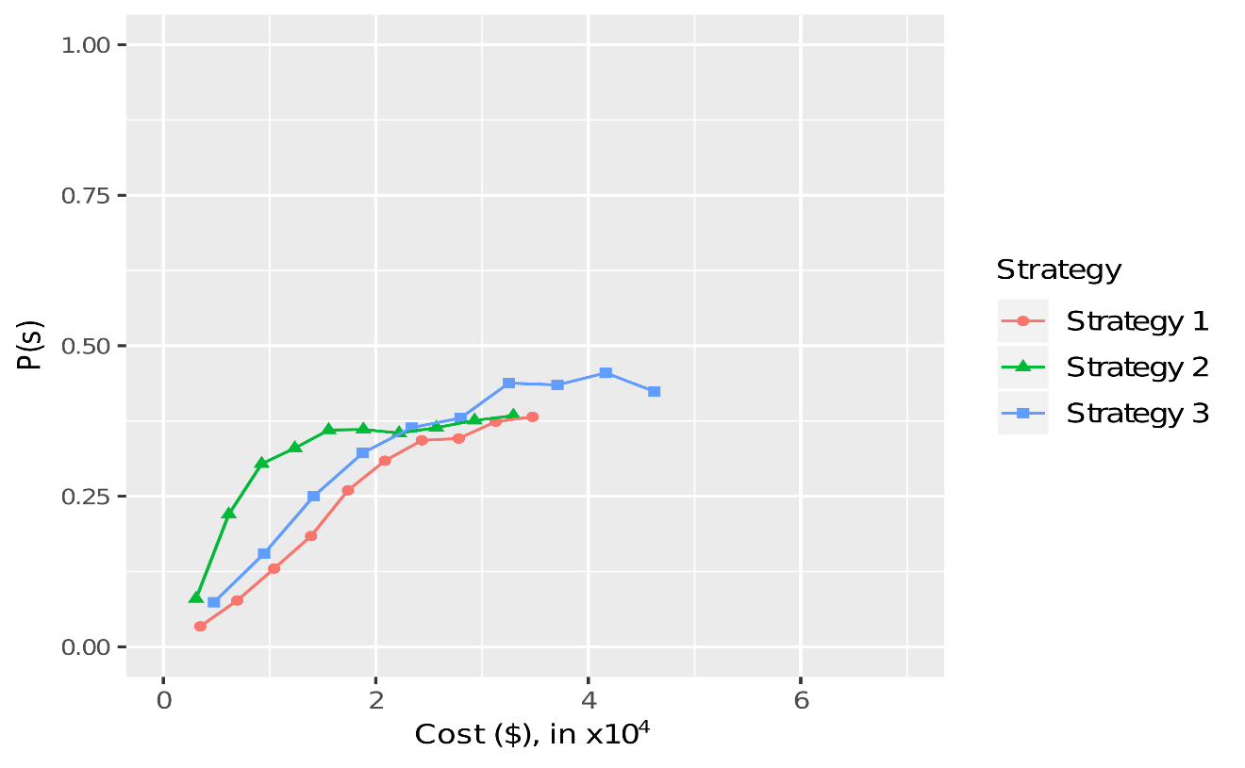
Example 1 : Develop at Least Four Successful ILs < 2 years.
ul markers placed 1/20 cM for backcross strategies 1,2,3
Cameron et al, 2017, TAG
Notes:
Selection Strategies 1 and 2 represent selection for ___ in the early BC generations followed by selection for el and background markers in the later generations. Strategy 3 represents selection for all 3 types of marker loci every generation.
Data points represent number of progeny generated in each BC generation. Peng et al identified Strategy 2 with 400 progeny per generation as producing the highest average values for recovery of the recurrent parent for the least cost.
None of their strategies met their own criteria for success (recall that was based on average recovery of donor genome)
Under the CTP framework, it appears that none of these first three strategies produced a very high probability of success.
Note that optimal point for strategy 2 occurs at about by doubling the cost strategy
In 2014 Herzog et al, suggested that greater saturation of the genome with marker loci would likely improve outcomes from selection strategies, so Strategies

Slide 12
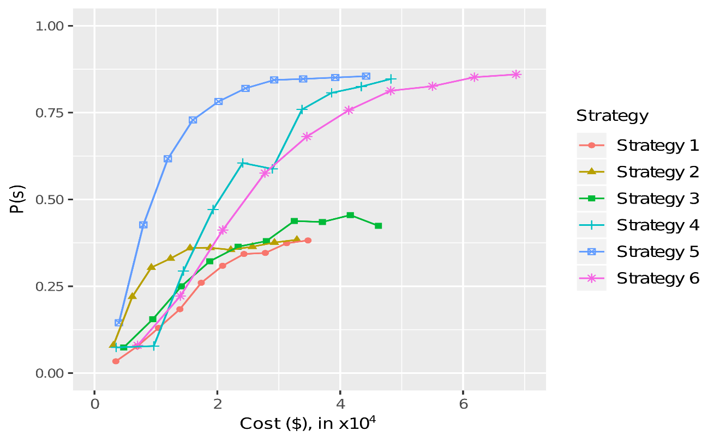
Example 1 : Develop at Least Four Successful ILs < 2 years.
ul markers placed 1/20 cM for backcross strategies 1,2,3
ul markers placed 1/10 cM for backcross strategies 4,5,6
Cameron et al, 2017, TAG
Notes:
In 2014 Herzog et al, suggested that greater saturation of the genome with marker loci would likely improve outcomes from selection strategies, so Strategies

Slide 13
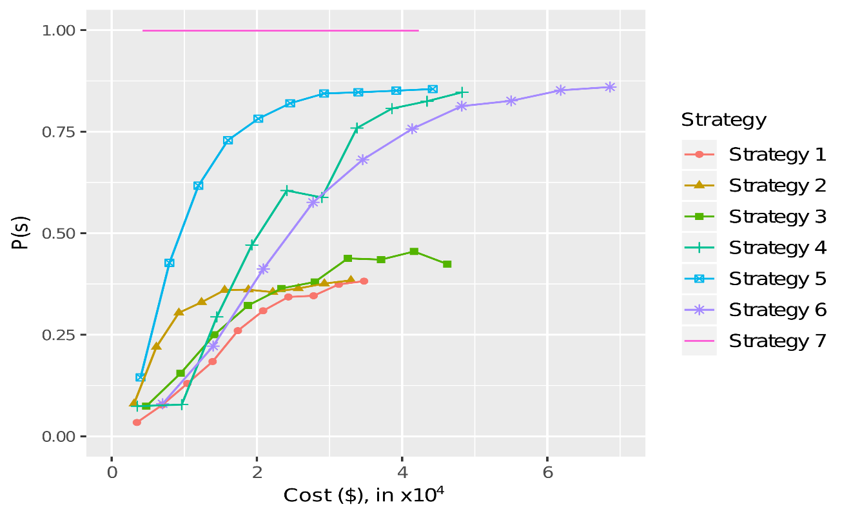
Example 1 : Develop at Least Four Successful ILs < 2 years.
Backcrossing Strategies Are Not Optimal for Introgression!
Cameron et al, 2017, TAG
Notes:
Selection Strategies 1 and 2 represent selection for ___ in the early BC generations followed by selection for el and background markers in the later generations. Strategy 3 represents selection for all 3 types of marker loci every generation.
Data points represent number of progeny generated in each BC generation. Peng et al identified Strategy 2 with 400 progeny per generation as producing the highest average values for recovery of the recurrent parent for the least cost.
Under the CTP framework, it appears that none of these first three strategies produced a very high probability of success.
Note that optimal point for strategy 2 occurs at about by doubling the cost strategy
In 2014 Herzog et al, suggested that greater saturation of the genome with marker loci would likely improve outcomes from selection strategies, so Strategies

Slide 14
Predicted Cross Value for all Possible Crosses Among 50 BC₁F₁ Progeny
Han et al, 2017. Genetics

Slide 15
Example 1:
Were there Multiple Objectives?
Objectives
Model
Algorithm
Solver

Slide 16
Example 2: Redesign Replicated Field Trials
Develop
Replicable
Genotypes
Replicated
Field Trials
Cross
Introgress
METs
Commercialize
Byrum et al, 2017. Interfaces
Notes:
Say something about time…. And why do we evaluate 4 years plus 2-3 years in METs and then more after commercialization?

Slide 17
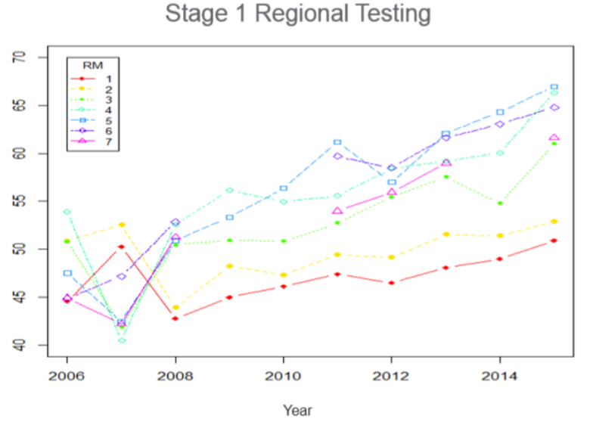
Outcomes from Redesigned Replicated Field Trials
Byrum et al, 2017. Interfaces

Slide 18
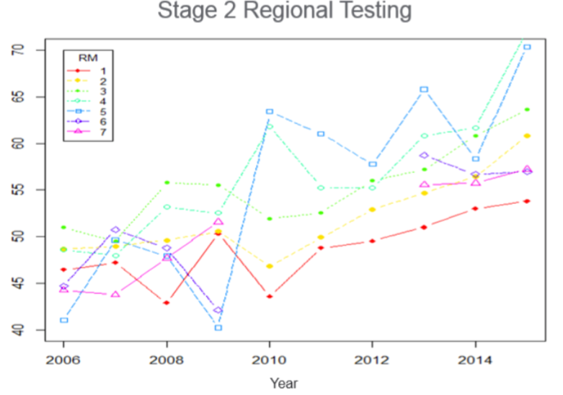
Outcomes from Redesigned Replicated Field Trials
Byrum et al, 2017. Interfaces

Slide 19
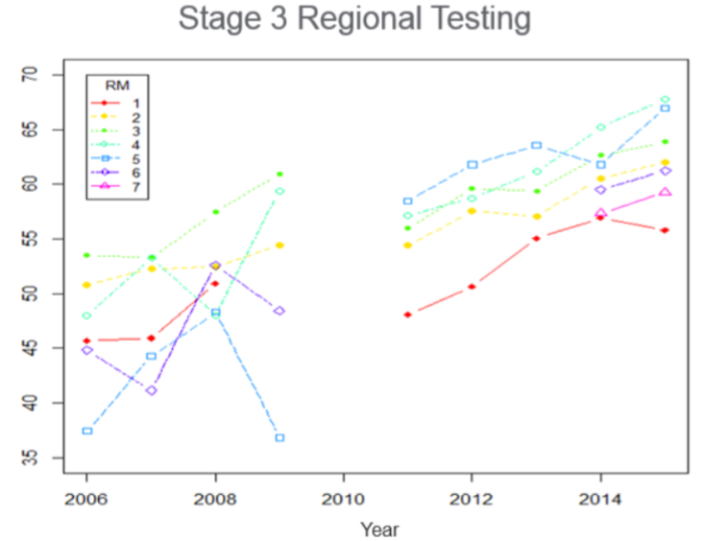
Outcomes from Redesigned Replicated Field Trials
Byrum et al, 2017. Interfaces

Slide 20
Is the Pipeline Cultivar Development Model Fundamentally Flawed?
Develop
Replicable
Genotypes
Replicated
Field Trials
Cross
Introgress
METs
Commercialize
RGS
Replicable
Genotypes
Field Trials
Introgress
METs
Commercialize
Gaynor et al 2017. Crop Science
Goranc et al, 2018. TAG
Notes:
Is it time to ca Modular Design
John Hickey and co-workers (Gaynor et al. 2017) also approached this question by deconstructing the winter wheat breeding program in the UK. Using genomic selection and simulation they suggested that the cyclical genetic improvement system should be redesigned to realize maximum genetic gains. Their work demonstrated that an optimal genetic improvement system for winter wheat could double genetic gain for yield. Is it time to deconstruct and redesign corn breeding systems?

Slide 21
RGS Encounters the Trade-offs of Recurrent Phenotypic Selection Faster
Recurrent selection will encounter limits to genetic gain that are less than the full genetic potential available in the founders (Robertson, 1960; Hill and Robertson, 1968).
What is the appropriate balance between maintaining genetic diversity (minimizing inbreeding) and maximizing response to selection?
Notes:
Optimizing multiple objectives (OMO) requires development of mathematical models that explicitly define trade-offs among conflicting objectives.
There are three primary components to OR approaches: objective functions, decision variables and constraints. Objective functions consist of measurable objectives that need to be minimized or maximized, e.g., minimize costs and time while maximizing the probability of success. Decision variables are components of the objective functions that we can control, e.g., how many plants to grow per generation, how many markers to assay, how many lines to select each generation, etc. Constraints are limitations on the decision variables and objective functions, e.g., budget restrictions, stages of phenology and reproduction on assay deadlines, size of field plots, etc.

Slide 22
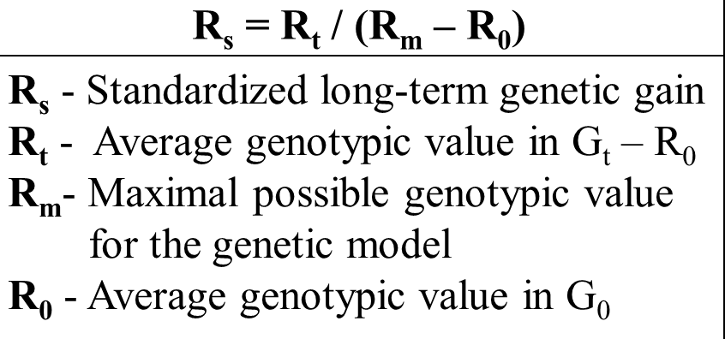
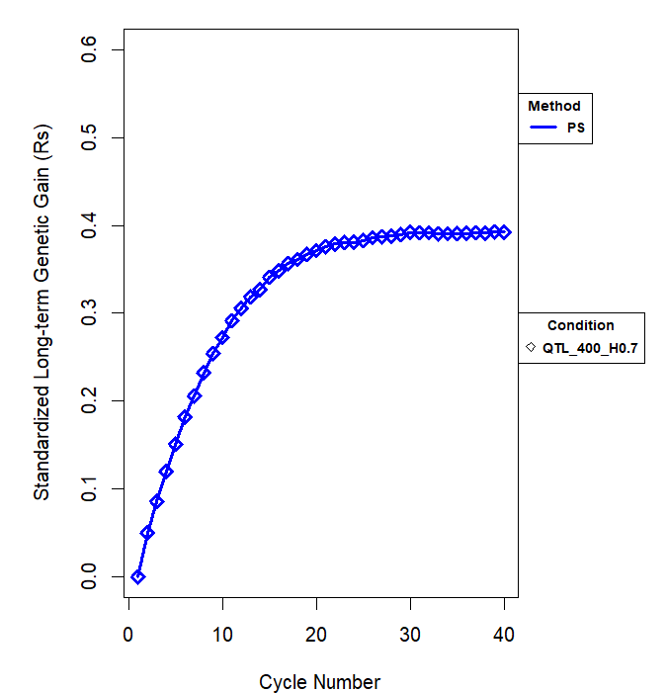
40 Cycles of Simulated Phenotypic Recurrent Selection
21 Soybean Founders adapted to MZ III
400 QTL , Vg/Vp = 0.7,
10% Selected
Ramasubramnanian, et al, 2019

Slide 23
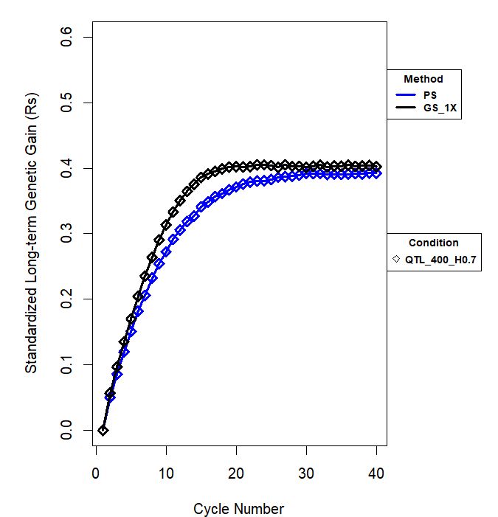
40 Cycles of Simulated Recurrent Genomic Selection
21 Soybean Founders adapted to MZ III
400 QTL , Vg/Vp = 0.7,
10% Selected
Ramasubramnanian, et al, 2019

Slide 24
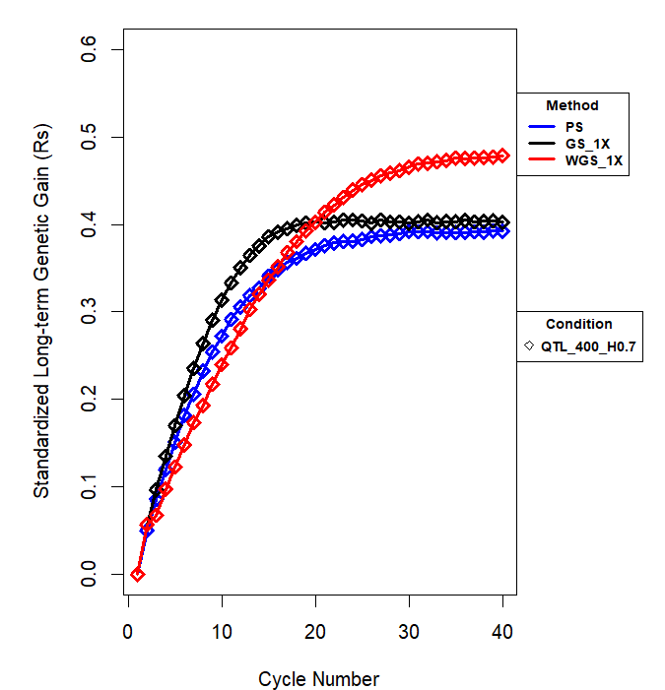
40 Cycles of Simulated Recurrent Weighted Genomic Selection
21 Soybean Founders adapted to MZ III
400 QTL , Vg/Vp = 0.7,
10% Selected
Ramasubramnanian, et al, 2019

Slide 25
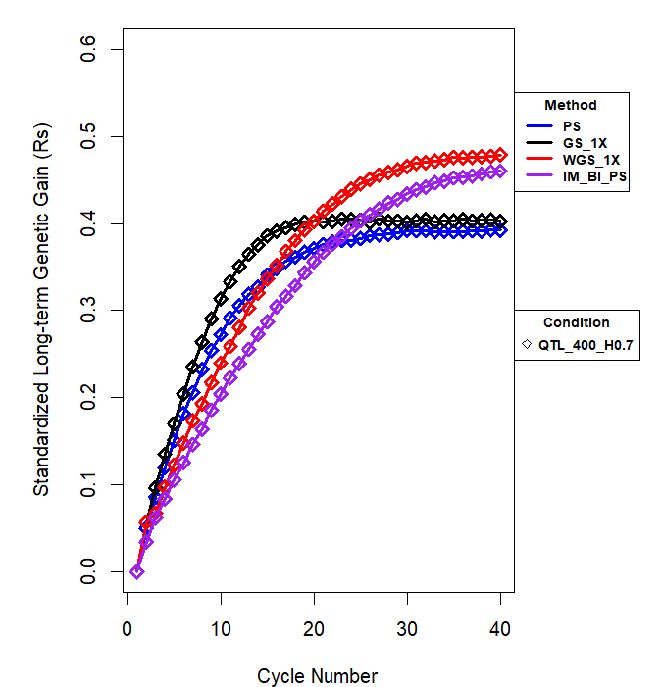
40 Cycles of Simulated Recurrent Island Model Phenotypic Selection
21 Soybean Founders adapted to MZ III
400 QTL , Vg/Vp = 0.7,
10% Selected
Ramasubramnanian, et al, 2019

Slide 26
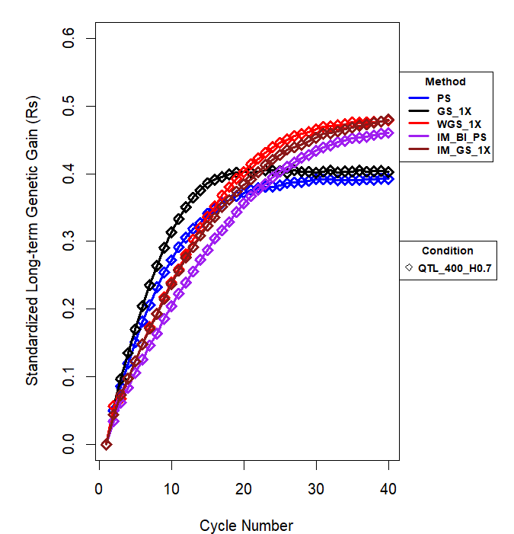
40 Cycles of Simulated Recurrent Island Model Genomic Selection
21 Soybean Founders adapted to MZ III
400 QTL , Vg/Vp = 0.7,
10% Selected
Ramasubramnanian, et al, 2019

Slide 27
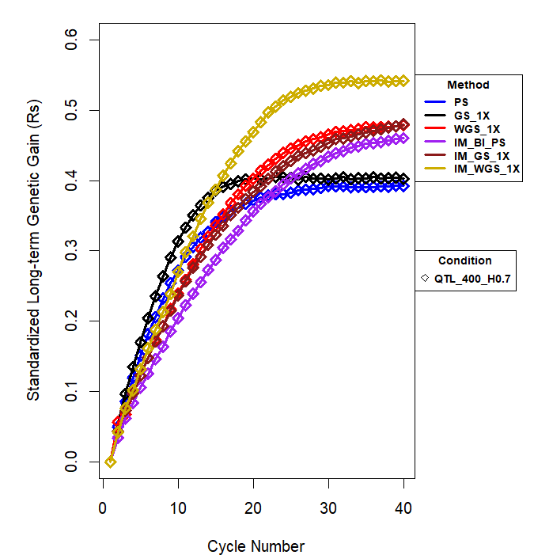
40 Cycles of Simulated Recurrent Island Model Weighted Genomic Selection
21 Soybean Founders adapted to MZ III
400 QTL , Vg/Vp = 0.7,
10% Selected
Ramasubramnanian, et al, 2019

Slide 28
A More Difficult Challenge for RGS
Maximize genetic gain for multiple traits while minimizing inbreeding
Historical plant breeding approaches:
Tandem Selection
Independent Culling (Hazel, 1943)
Multi-stage Selection
Selection Index (Hazel and Lush, 1942)
Applied mathematics approach:
Translate k traits into k objective functions
Simultaneously optimize k+1 objective functions

Slide 29
Multi-trait Selection: Selection Index
Notes:
We’ve been talking, however, about returning to recurrent selection where product development can be used to provide training sets for obtaining GEBVs to be used for decision making in the rapid cycling and Gary asked me to revisit selection indeces.
Seems like a reasonable decision tool, but what are the limitations?
In practice, it can be very difficult to precisely and accurately select the weights, even for someone familiar with marketplace. Why? Forecast value of traits in the marketplace? Anecdote about corn borer and herbicide resistance. -Stochastic programming.

Slide 30
Translate k Traits into k Objective Functions
Deb, 2001
Konak et al, 2006
Notes:
x is a vector of decision variables, for example estimated breeding values at marker loci distributed throughout the genome.

Slide 31
Approaches to Simultaneously Optimize k Objective Functions
Scalar methods, e.g., weighted sum
constraint method
Identify Pareto optimal solution sets and their associated Pareto front
Deb, 2001
Konak et al, 2006
Notes:
Multi-objective Optimization
Combine individual objective functions into a single composite function and optimize it, e.g., weighted sum.
Optimize a single objective function and let other objective functions become constraints on the decision variables
Determine a Pareto optimal solution set

Slide 32
Weighted Sum Scalar Method
If KKT conditions exist, then a best solution exists.
Deb, 2001
Konak et al, 2006
Notes:
X are the decision variables (e.g., Genomic Estimated Breeding Values for each trait).
Constraints include the number of markers used to obtain the GEBVs, the number of lines evaluated, number of individuals (lines, hybrids, families, etc.) evaluated for phenotypes in a training set…
Z’ is the normalized objective function and Sum(wi) = 1.
If KKT do not exist, then there are better solutions, primarily because the Selection Index will not include individuals with best alleles for some traits, i.e., likely to lose valuable alleles in creating the next generation!!!!

Slide 33
Identify Pareto Optimal Sets
A Pareto optimal set consists of solutions that are non-dominated with respect to each other.
More formally for a set of maximization objectives:
max
Trait 2
Trait 1
max
Deb, 2001
Konak et al, 2006
Notes:
Intuition about non-dominated set….
Points can represent phenotypes, GEBVs, Utility metrics for progeny from pairs of crosses.
Notice that while choosing among solutions within a non-dominated set there is always sacrifice or trade-offs among the objectives.
Pareto optimal solution sets are often preferred to single solutions because they can be practical when considering real-life problems since the final solution of the decision-maker is always a trade-off

Slide 34
Genetic Contributions to the Next Generation
max
Use the non-dominated set as parents for the next generation.
Trait 2
Trait 1
max
Deb, 2001
Konak et al, 2006
Notes:
Demonstrate how with subset of lines
Breeding values for two traits in a set of lines

Slide 35
Genetic Contributions to the Next Generation
Parental contributions based on distance from a feasible ideal
max
Trait 2
Trait 1
max
Akdemir et al, 2018
Notes:
Consider an feasible ideal --- we know that it is feasible to obtain values for trait 1 as high as and as high as for trait 2. Thus, it is possible to have a P, GV, GEBV, utility value, etc
Weight based on the inverse of the distance between the ideal and actual P, GV, GEBV, A reasonable distance metric to use euclidean distance, but other metrics can be used and the MOO literature describes the outcomes from various possible weights on the outcomes to GA and Evol A.

Slide 36
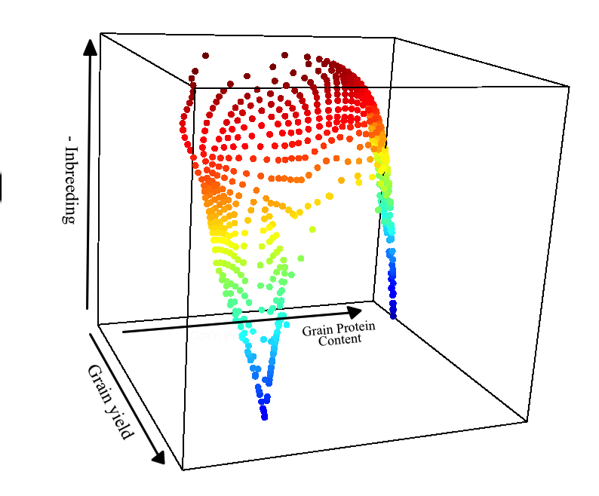
Contributions for Negative Correlated Traits and Minimize Inbreeding
Akdemir et al, 2018
Notes:
Explain what psi is
Visualization for k >3: SOMs. (Obayashi and Sasaki, 2003)

Slide 37
Simulated Comparison of Multi-trait Selection Approaches
3000 marker alleles with initial f(a)=0.5 in diploid individuals
Random mate (100, 200, 300, 400) individuals for 100 generations. Tandem PS for 10 generations
k=2 traits, h²=0.5, (t1, t2) = -0.5
600 uniformly distributed QTL
a_{Q}=+/-(1/600)
30 replicates
Breeding objectives:
Max T_{1,} Max T_{2,} Max –Inbreeding
Selection strategies:
PS(SI), PS(Tandem), PS(Cull), GS(SI), GS(SI), GS(Tandem), GS(Cull),
GS(NonD), OMOD₁, OMOD₁
i=0.05 (N=100, 200), i=0.10 (N=300, 400)
Akdemir et al, 2018

Slide 38
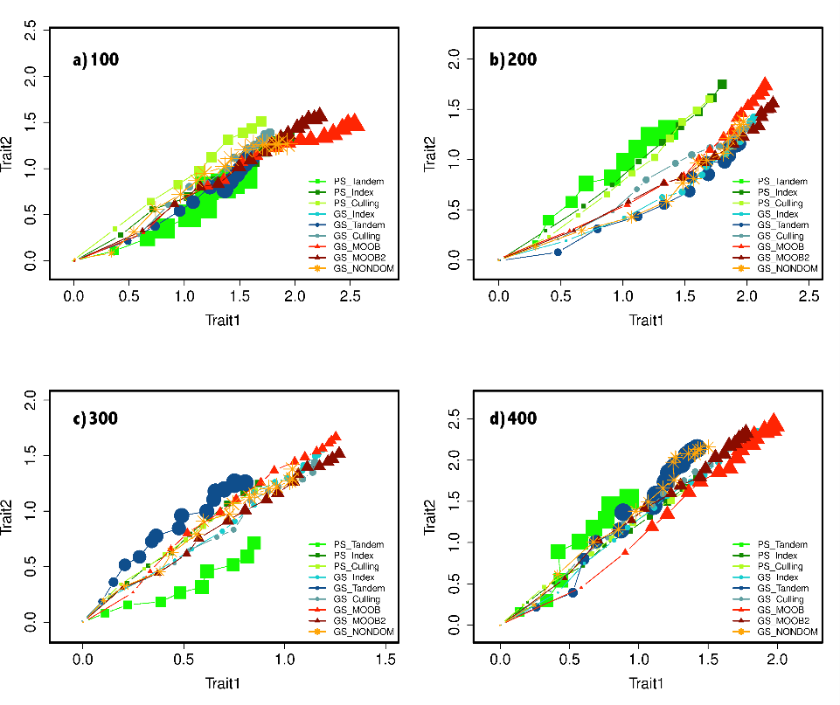
Simulated Responses to 16 Cycles of Recurrent Selection
1.2xGS(SI)<OMOD₁
Akdemir et al, 2018

Slide 39
The Most Difficult Challenge for RGS (For all Plant Breeding Systems)
Select multiple traits needed for adaptation to emerging future environments.
What are the most likely distributions of future environments?
Are we measuring the right traits for adaptation to future environments?
Crop Modeling
What product profile will provide a successful future cultivar?
Do we know the genetics underlying adaptation traits?
Do we have alleles that will enable adaptation to predicted environments?

Slide 40
Summary:
If we are going to reclaim our birthright as designers of plant breeding systems, then we will need to learn to think like an engineer.
Clearly define measurable objectives: What product profile will be recognized as a successful outcome?
Learn how to quantify and communicate trade-offs among multiple objectives.
Pressure to produce adapted high quality cultivars as fast as possible, for minimal cost. We must communicate that two of the three are possible.

Slide 41
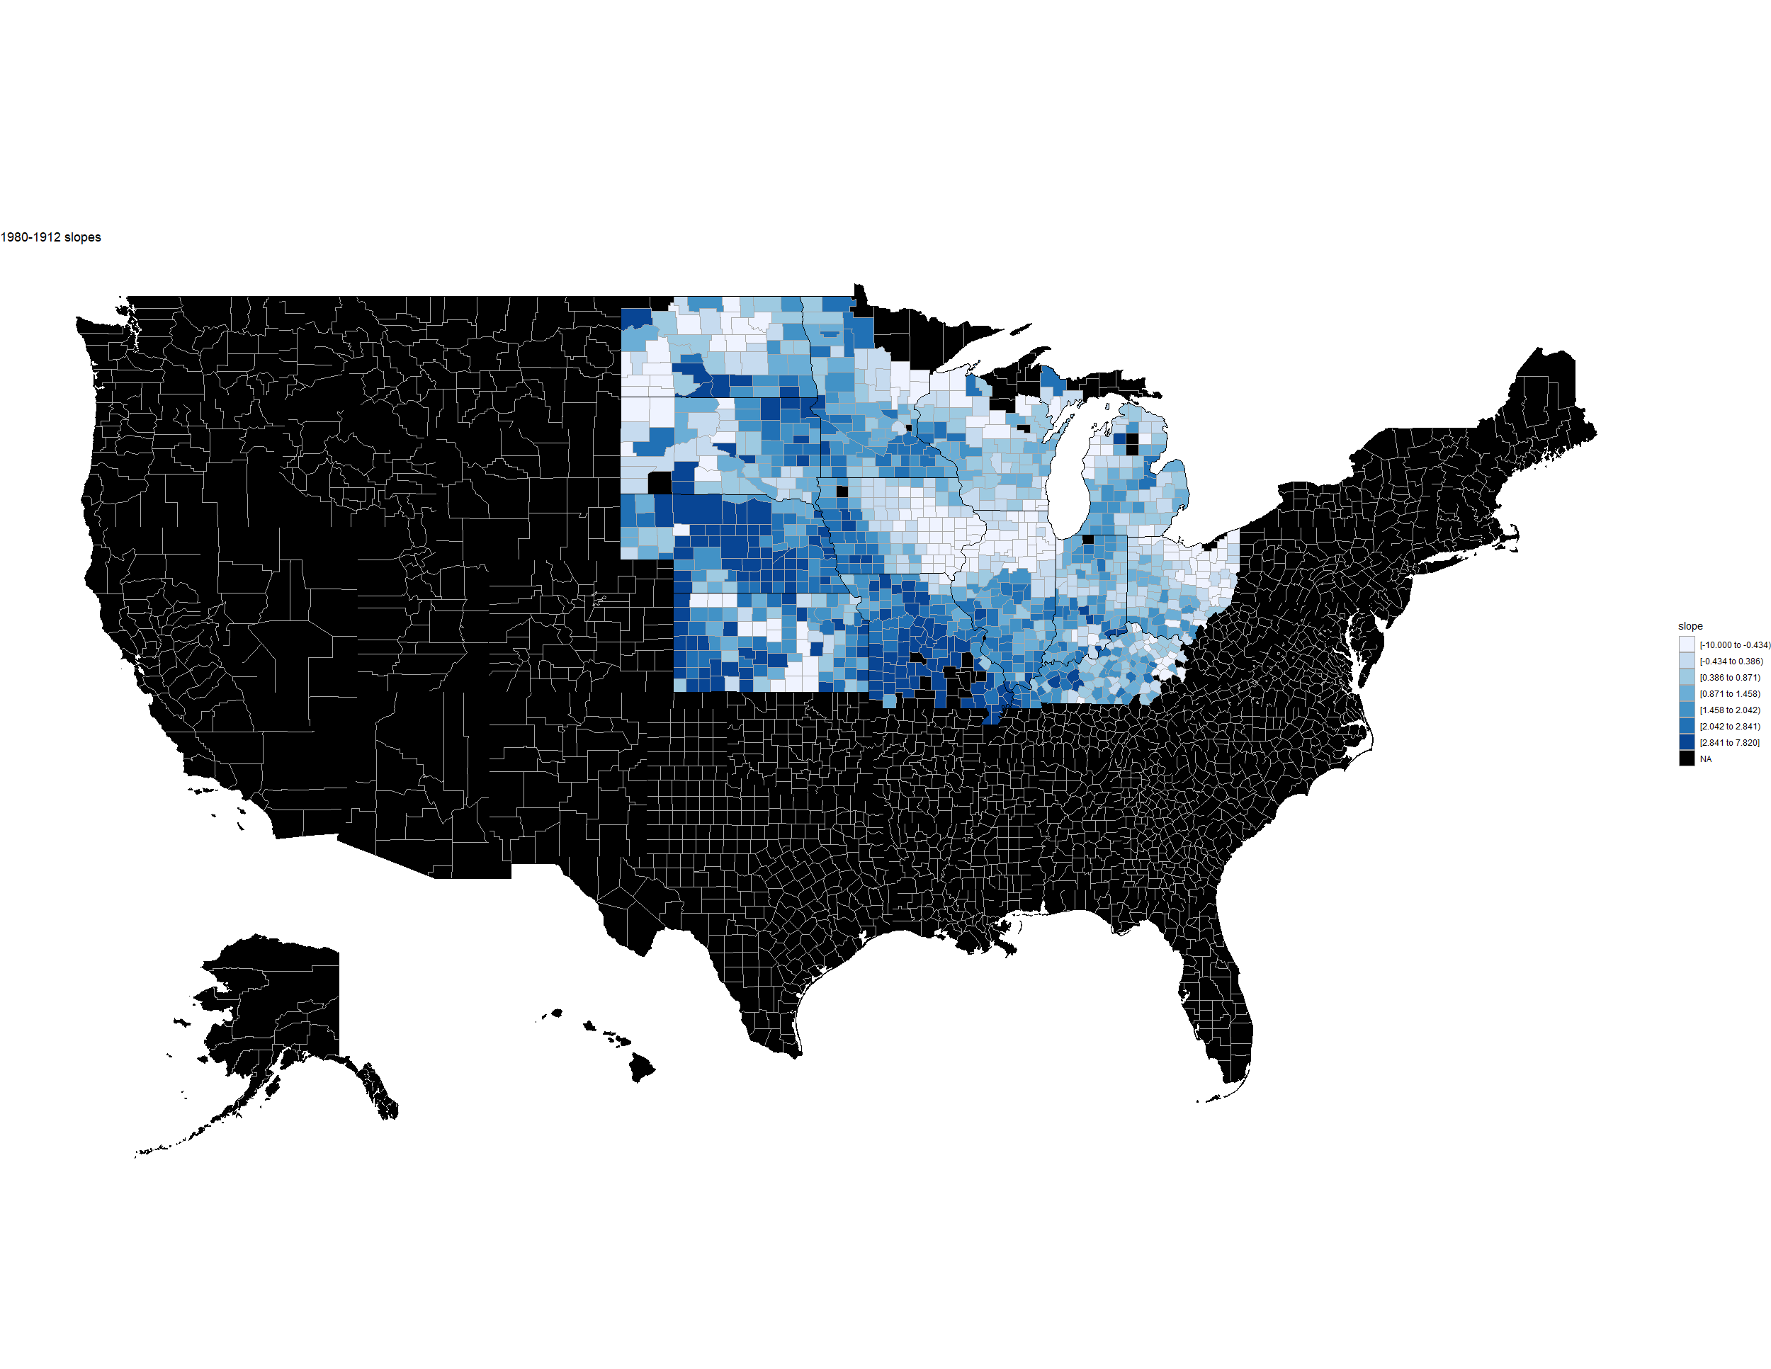

Slide 42
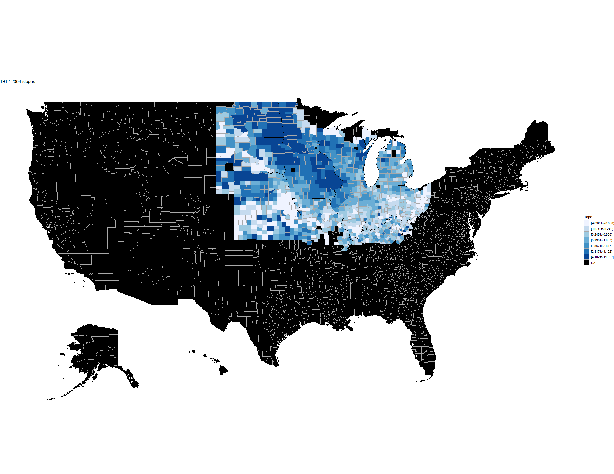

Slide 43
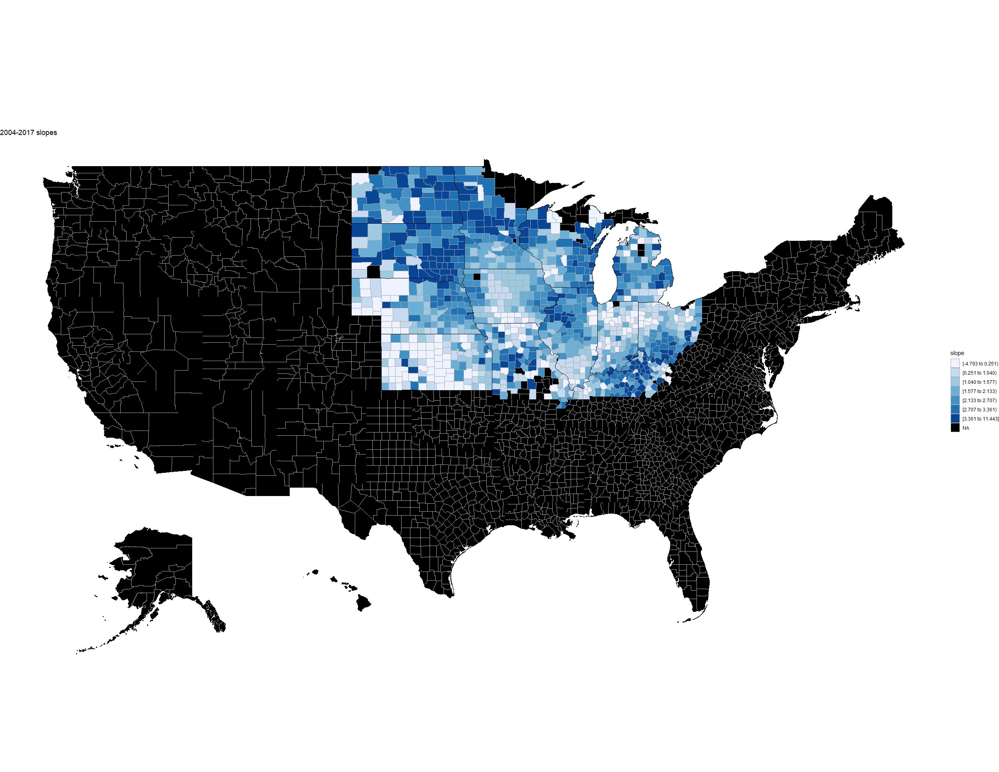

Slide 44
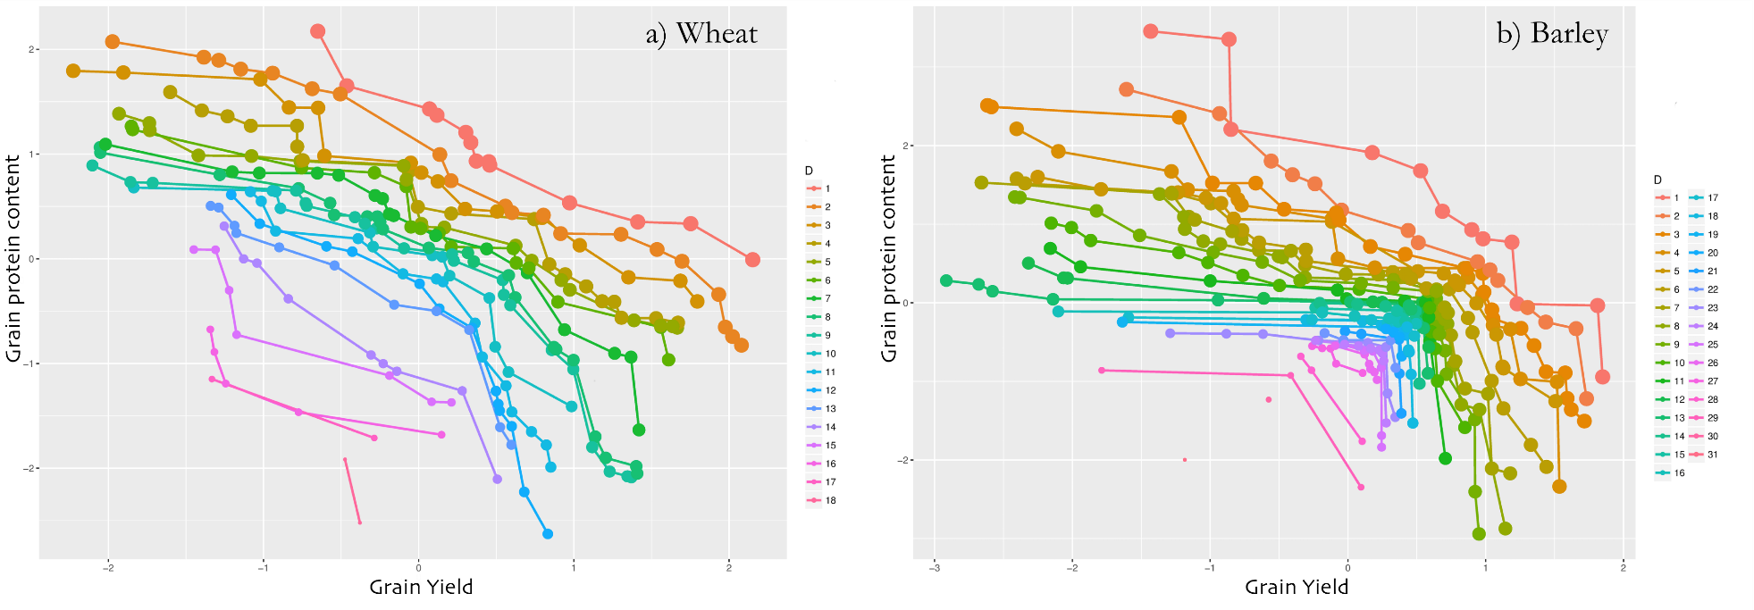
Pareto Front for yield and protein in wheat and barley
Akdemir et al 2018
Notes:
There exists software to identify the non-dominated sets, for multiple levels. 1st level, is max. 2nd level is the non dom set that emerges after the first non-dom set is removed.

Slide 45
What are an Optimal Plant Breeding Systems?
Optimization: A process or methodology of making a design, system or decision as effective and efficient as possible, specifically through mathematical procedures. – Merriam Webster.
Notes:
Optimizing multiple objectives (OMO) requires development of mathematical models that explicitly define trade-offs among conflicting objectives.
There are three primary components to OR approaches: objective functions, decision variables and constraints. Objective functions consist of measurable objectives that need to be minimized or maximized, e.g., minimize costs and time while maximizing the probability of success. Decision variables are components of the objective functions that we can control, e.g., how many plants to grow per generation, how many markers to assay, how many lines to select each generation, etc. Constraints are limitations on the decision variables and objective functions, e.g., budget restrictions, stages of phenology and reproduction on assay deadlines, size of field plots, etc.

Slide 46
Parental Contributions and Minimize Inbreeding
Akdemir et al, 2018
Notes:
Explain c, v,
Visualization for k >3: SOMs. (Obayashi and Sasaki, 2003)

